Slide 1
Multi-PCIe socket network device
Achiad Shochat
Netdev 2.2, Nov-2017, Seoul

Slide 2
Problem description

Slide 3
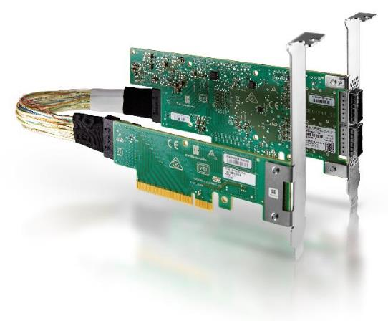
Introduction
Until recently all NICs had a single PCIe bus connectivity to the server
NICs with multiple PCIe bus connectivity are beginning to show up
The motivations are described in the following slides

Slide 4
Port BW > PCIe BW
CPU
CPU
PCIe
Gen3 x16
PCIe
Gen3 x16
PCIe
Gen3 x16
PCIe
Gen3 x16
100 Gb/s
100 Gb/s
100 Gb/s
NIC
NIC
PCIe I/F
PCIe I/F
PCIe I/F
PORT
PORT
200 Gb/s
200 Gb/s

Slide 5
NUMA system, NIC with single PCIe bus
CPU 0
CPU 1
MEM
Core
☹
Core
☹
QPI
Core
☺
Core
☺
MEM
PCIe Socket
PCIe Socket
PCIe
I/F
NIC
Port
Network

Slide 6
NUMA system, NIC with multiple PCIe buses
CPU 0
CPU 1
MEM
Core
☺
Core
☺
QPI
Core
☺
Core
☺
MEM
PCIe Socket
PCIe Socket
NIC
PCIe
I/F
PCIe
I/F
Port
Network

Slide 7
Multi-host NIC
HOST A
HOST B
CPU 0
CPU 0
MEM
Core
☺
Core
☺
Core
☺
Core
☺
MEM
PCIe Socket
PCIe Socket
NIC
PCIe
I/F
PCIe
I/F
Port
Network

Slide 8
Software model

Slide 9
N/A for multi-host
Since in the multi-host NIC case each server sees just a single NIC PCIe bus
The server is not aware of sharing the network port with other servers

Slide 10
Netdev per port
netdev
SW
Model
PCI
device
PCI
device
Physical
Elements
PCIe
I/F
PCIe
I/F
Port
Aligned with the netdev per port kernel convention
Layers partitioning
  PCI subsystem is unaware - PCI device per PCI bus
  Net subsystem is unaware – network device per network port
  The whole aggregation logic is encapsulated in the network device driver
Symmetric modeling of the physical elements
Good Out-Of-Box experience, no admin configurations

Slide 11
Netdev creation
Create a netdev per PCI probe does not fit
Static approach
  Create the netdev only when all PCIe buses of the device are probed
Dynamic approach
  Create the netdev upon probe of first PCI bus of the device
  Requires dynamic adjustment of the netdev/device resources
    Since some device resources are per PCI bus (e.g #RX/TX queues)
  Complicated…
Multi-PCIe bus device detection
  Device specific method
  Reasonable since it is the device driver that handles the PCI devices aggregation into a single netdev

Slide 12
Why not Linux bond/team
Breaking the netdev per port convention
  Creates ambiguity when it comes to device management
  For example
    Which slave I/F shows the physical port speed?
    On which slave netdev should flow steering rules be applied?
No straightforward mean to affine RX traffic to PCIe bus
Redundant netdevs burden in the system
Cumbersome admin management
  Not working Out-Of-Box
  Need to apply configurations per slave netdev (e.g RSS, ethtool settings)

Slide 13
TX/RX queues PCIe bus affinity
Ordering must be kept within a given TX/RX queue
The PCI-SIG spec does not guaranty any ordering between different PCIe buses
Conclusion: each TX/RX queue must be affined with a single PCIe bus
TX/RX queues are already affined with CPU cores
NUMA systems
  Affine queues with the local PCIe bus of the core they are associated with
Non NUMA systems
  Distribute the queues evenly among the device PCIe buses

Slide 14
Device resources management
Through which PCIe bus?
Vendor specific policy
Might be
  Option 1
    Through one of the buses
  Option 2
    Affined resources (TX/RX queues) through their designated bus
    Non-affined resources (RSS indirection table, flow steering) through one of the buses
  Option 3
    Any resource through any bus

Slide 15
aRFS (Accelerated Receive Flow Steering)
The NIC needs to support flow steering rules pointing to an RX queue affined with any PCIe bus
Naturally enforces locality in NUMA systems
Eliminates DMA traffic on the QPI

Slide 16
RSS (Receive Side Scaling)
CPU
Core
Core
Core
Core
The NIC needs to support a single indirection table where each entry may point to an RX queue affined with any PCIe bus
Implicitly controls the load balance over the device PCIe buses
Implicitly controls the load balance over NUMA system memories
R
X
Q
#1
R
X
Q
#2
R
X
Q
#3
R
X
Q
#4
PCIe
Gen3 x16
PCIe
Gen3 x16
NIC
PCIe I/F
PCIe I/F
RSS indirection table
4
2
1
2
3
2
4
1
RX traffic

Slide 17
Virtualization

Slide 18
SR-IOV
Need to configure the virtualization management SW to assign VMs with VF per PCIe bus
VM A
VM B
VM C
PCIe
socket
PCIe
socket
PCIe
socket
PCIe
socket
PCIe
socket
PCIe
socket
VF1
VF2
VF3
VF1
VF2
VF3
PF0
PF0
NIC
PCIe I/F
PCIe I/F
Port

Slide 19
Congestion

Slide 20
RX traffic congestion
Congestion on one PCIe bus may propagate and block traffic destined to other PCIe buses
Very likely to happen in case a single PCIe bus BW is smaller than the network BW
The device should deploy some method to avoid that, e.g the WRED (Weighted Random Early Drop) algorithm
CPU
PCIe I/F
#1
PCIe I/F
#2
PCIe
Gen3 x16
PCIe
Gen3 x16
100g
100g
packet 1
100 Gb/s
100 Gb/s
packet 2
Port RX
Buffer
packet 3
NIC
packet 4
PCIe I/F
PCIe I/F
packet 5
packet 6
PORT
200 Gb/s
200g

Slide 21
Some NUMA performance numbers

Slide 22
System info
Server
  Dell R730 CPU E5-2687W v4 @ 3.00GHz
  Running at 3.2GHz no HT 24 cores
OS
  RH7.3
NIC
  Mellanox ConnectX-4
  Eth port speed: 100g
  2 PCIe gen3 x8 sockets

Slide 23
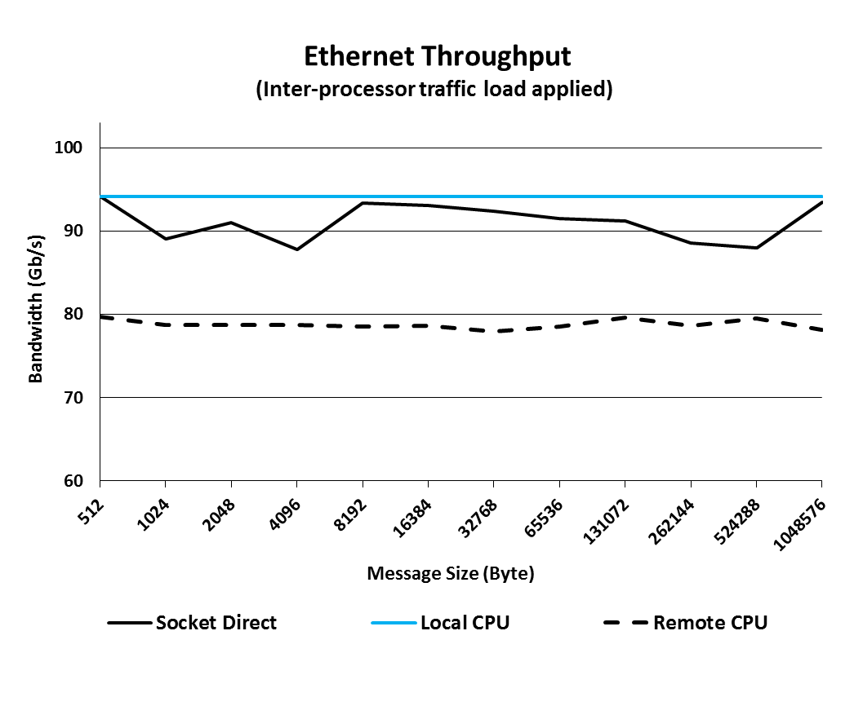
Network throughput with SW QPI load

Slide 24
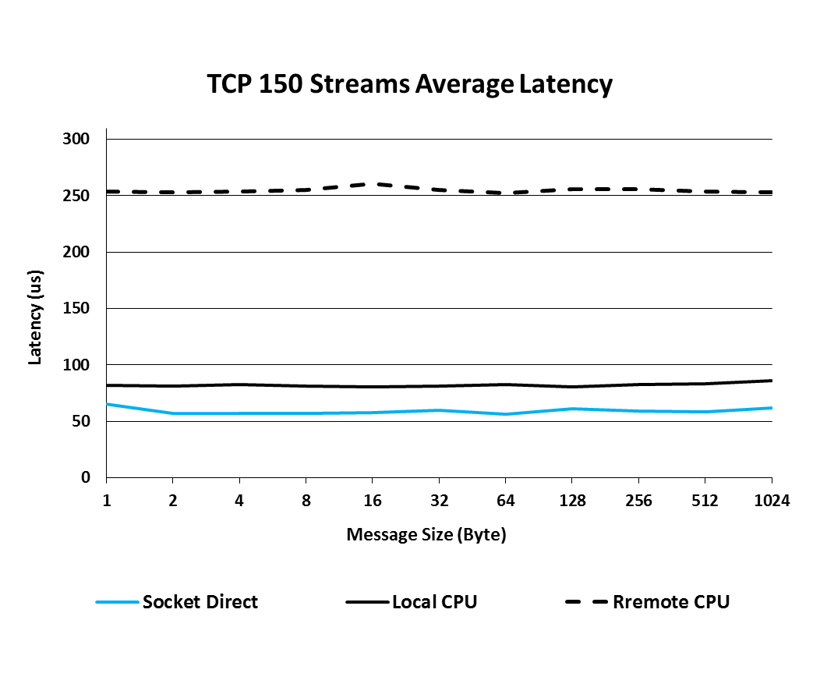
TCP latency

Slide 25
Thank You

